Slide 1
Measurement Lab Independent Network Performance Measurement
Chris Ritzo
Project Manager, Measurement Lab
Open Technology Institute, Washington, DC
Presentation to NBTC Bangkok, Thailand – 2/16/2015
Notes:
As the Internet drives economic and social development, national telecommunications regulators and service providers have an interest in performance data that reflects real-world conditions. Measurement Lab (M-Lab) provides the largest open repository of performance data, collected from broad sample populations, that reflects end-user conditions based on software integrations and partnerships. This dataset is currently used by governments and public interest organizations across North America and Europe, in order to assess the deployment and performance of broadband connectivity. The most recent research from M-Lab’s data exposed episodes of persistent congestion across the United States over the past three years due to network interconnection disagreements. As M-Lab builds out its infrastructure to include more international coverage, it has sought to promote the use of its existing data and increase collaborations in Asia. This presentation will serve as an introduction to the platform as a public resource that provides open, methodologically-based performance and transparency data from the edge, in order to prompt greater use of existing data and tools amongst the providers, regulators and organizations that have an interest in promoting reliable access. We will introduce the measurements that M-Lab is currently collecting and then describe how to access this information through newly release toolkits. The presentation will then use the technical findings of the interconnection study, including discovery of prioritization regimes, to demonstrate trustworthy measurement on controversial issues as a third-party to an underlying network relationship. This presentation will also offer an update on new developments with M-Lab, including new tests and Asian sites, and conclude with an invitation for further collaboration.

Slide 2
Overview of Measurement Lab

Slide 3
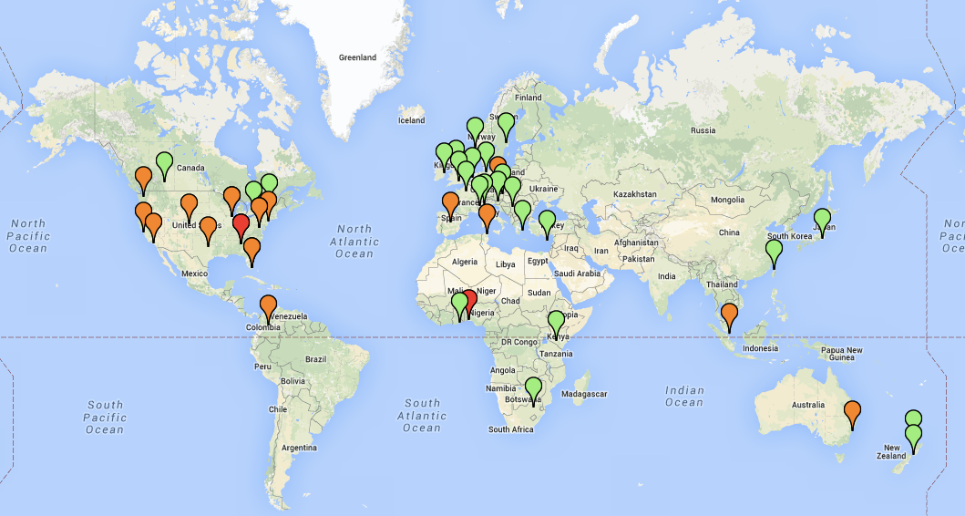
M-Lab’s Global Footprint
Servers on Every Continent and Growing
Notes:
NDT (200,000 tests per day)
Tests of traffic shaping
Path Data for Each Test

Slide 4
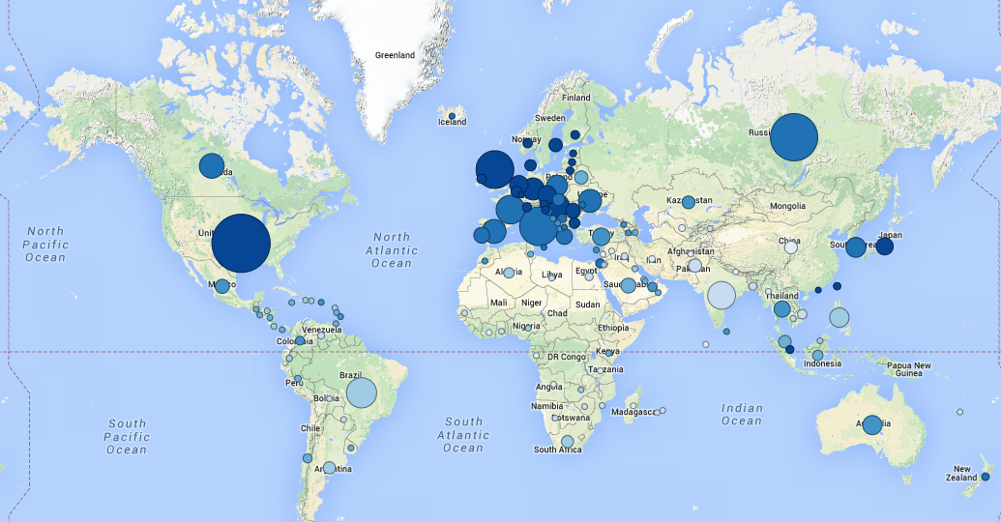
M-Lab’s Global Footprint
Tests from Every Country

Slide 5
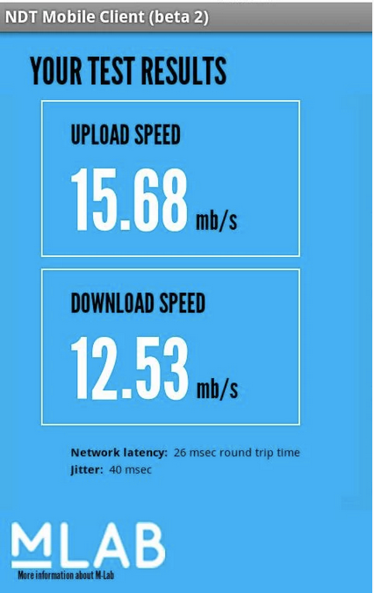
Throughput Measurements
M-Lab hosts two active throughput measurements:
Network Diagnostic Tool (NDT)
BISmark
NDT is integrated with numerous applications and receives 200,000 tests from 100,000 clients per day.
Nearly every country is well-covered.

Slide 6
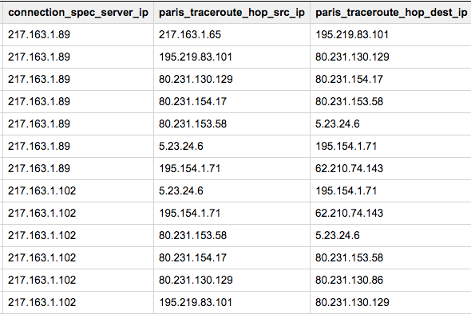
Path Information
Measurement Lab collects paris-traceroutes for every attempt to connect to its sites.

Slide 7
Consumer Measurement Methodology of Measurement Server Placement at the Network Edge

Slide 8
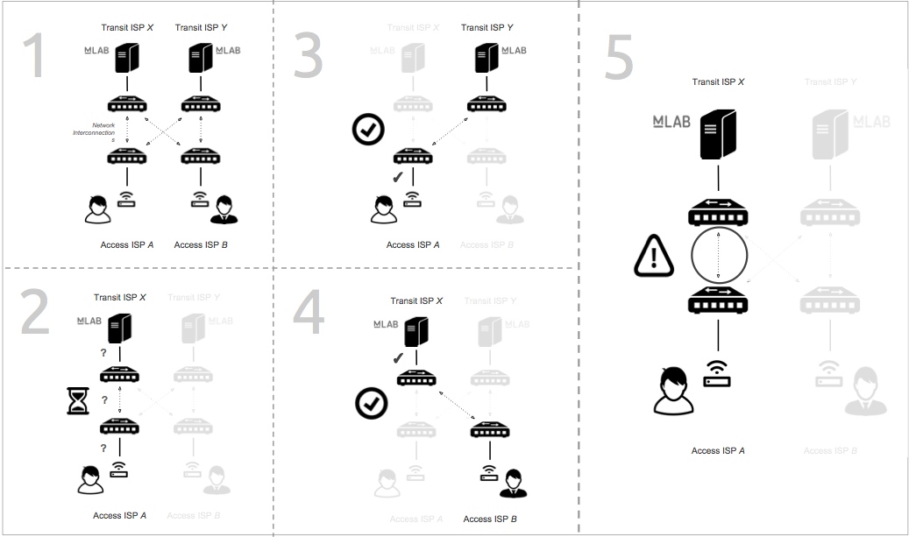
Methodology of Measurement Server Placement
Inferring differences in metrics M-Lab measures

Slide 9
Methodology of Measurement Server Placement
Inferring differences in metrics M-Lab measures

Slide 10
Methodology of Measurement Server Placement
Inferring differences in metrics M-Lab measures

Slide 11
Methodology of Measurement Server Placement
Inferring differences in metrics M-Lab measures

Slide 12
Methodology of Measurement Server Placement
Inferring differences in metrics M-Lab measures

Slide 13
Consumer Measurement Methodologies of M-Lab Tests

Slide 14
Each M-Lab test is produced by one or more independent researchers
NDT – Maintained by Internet 2
http://www.measurementlab.net/tests

Slide 15
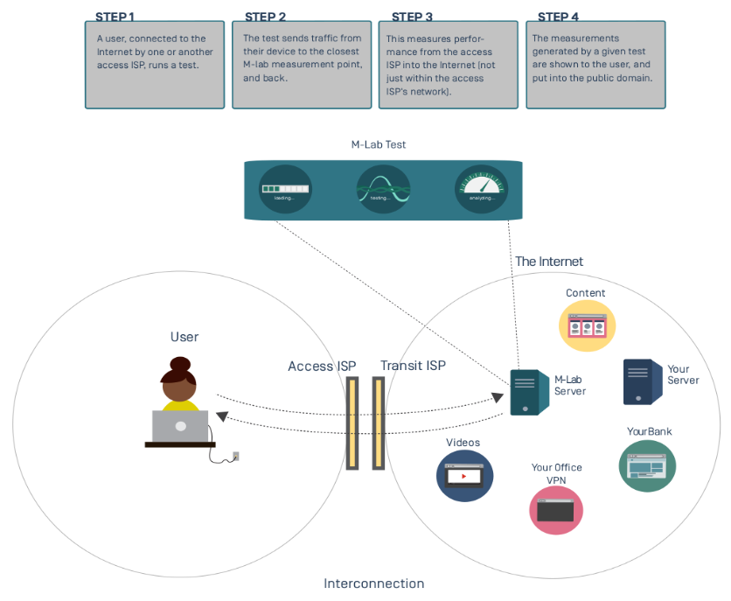
How Measurement Lab Collects Information
Measurements From Everyone

Slide 16
Overview of M-Lab NDT test data (Thailand, 2015/01 – 2015/02)
What variables are collected? https://cloud.google.com/bigquery/docs/dataset-mlab
Data that has been submitted in 2015 to date M-Lab, NDT Tests, Thailand, 2015/01-02 Sample Map (in development)
Reporting Support US Interconnection Study Methodology BigQueries used to generate Above Report
Report, Query, Research Support Documentation (DRAFT)
http://goo.gl/4htv2z

Slide 17
Raw Data Access and Processed Data Extraction Tools
Resources to run reports and also to support potential NBTC partners in the Thai academic community

Slide 18
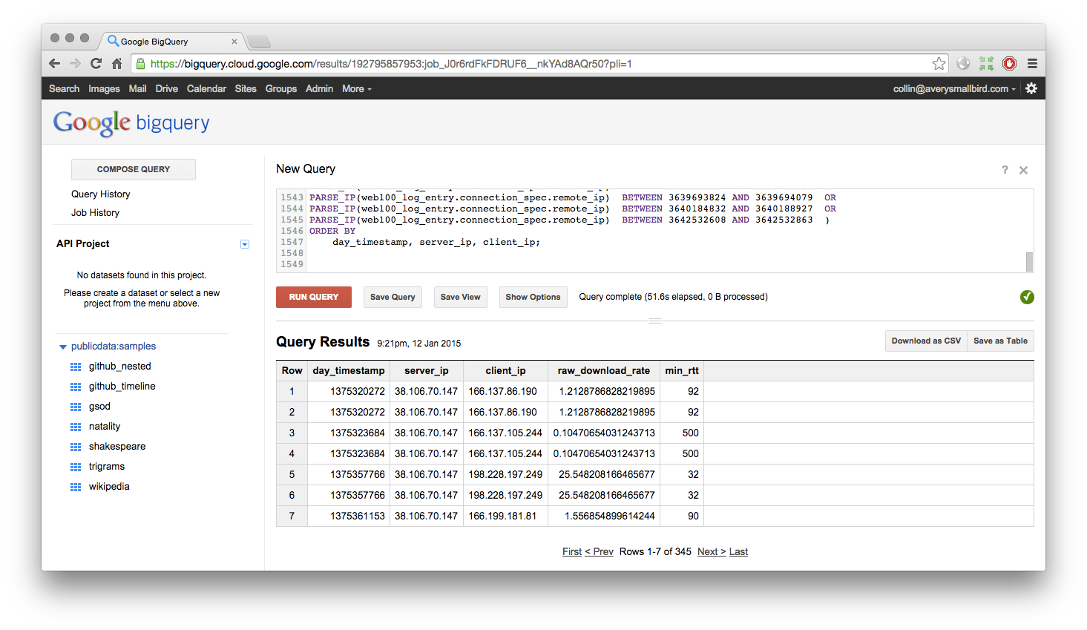
Raw Data: BigQuery Web Access
Structured Database Access

Slide 19
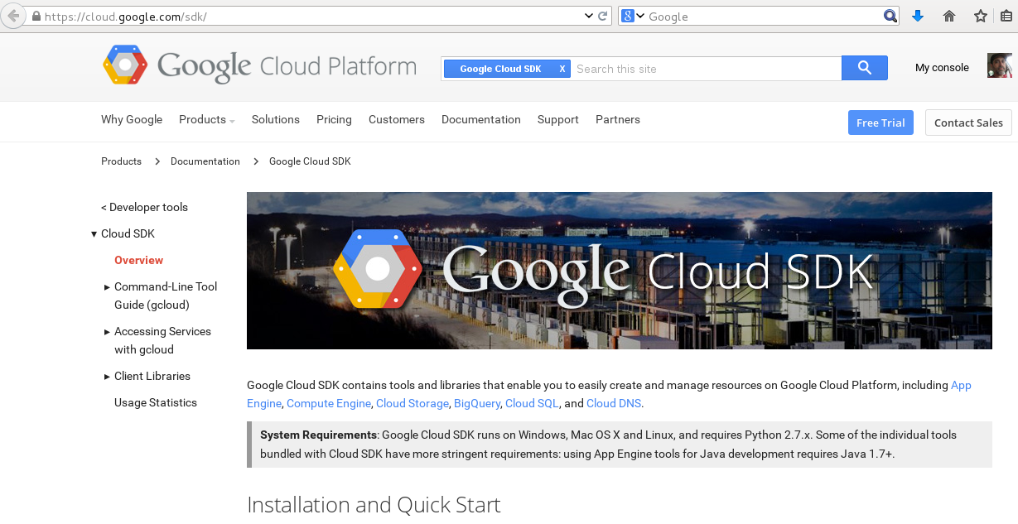
Raw Data: BigQuery Google Cloud SDK
Structured Database Access
http://cloud.google.com/sdk/

Slide 20
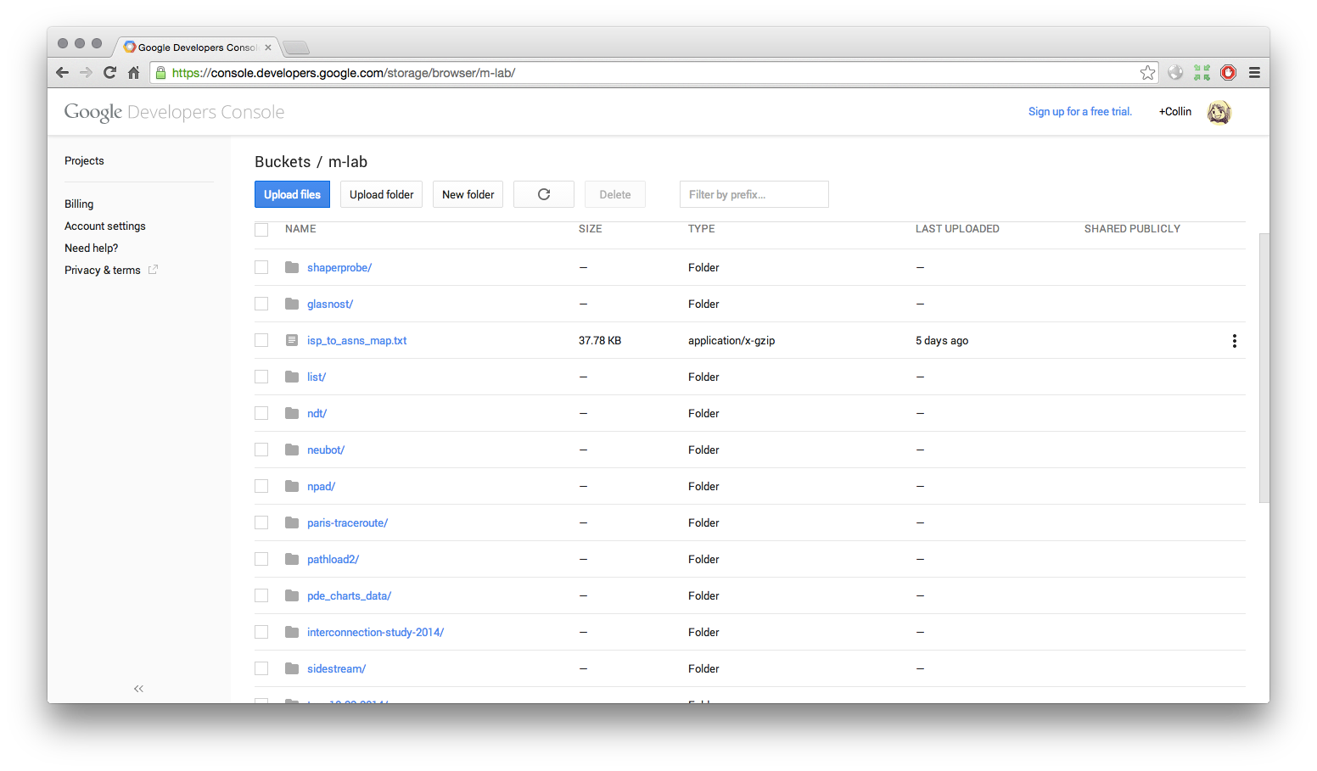
Raw Data: Cloud Storage
Raw Datafile Access

Slide 21
How Other National Regulators are Using M-Lab Data Potential Futures for NBTC

Slide 22
National Regulators and Others Using M-Lab
United States http://www.fcc.gov/reports/measuring-broadband-america-2014
Greece http://hyperiontest.gr/
Austria https://www.netztest.at/en/Karte
New Zealand http://nzbt.org.nz/
Canada http://204.101.134.249/static/index.html

Slide 23
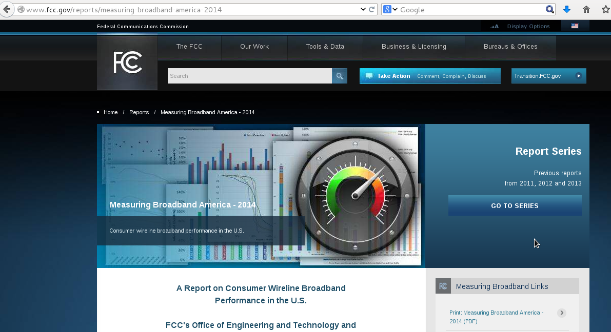
United States (FCC) - http://www.fcc.gov/reports/measuring-broadband-america-2014

Slide 24
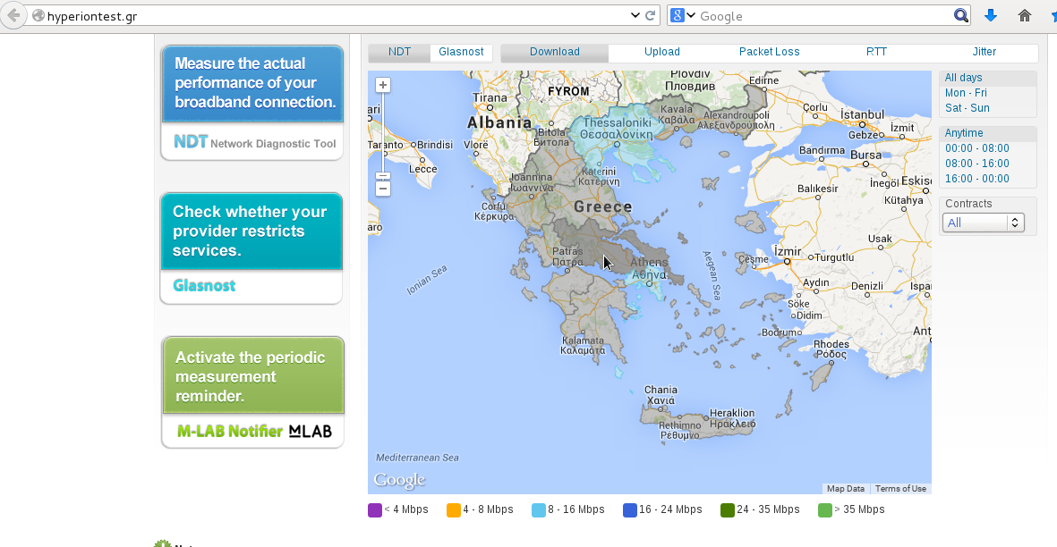
Greece - http://hyperiontest.gr/

Slide 25
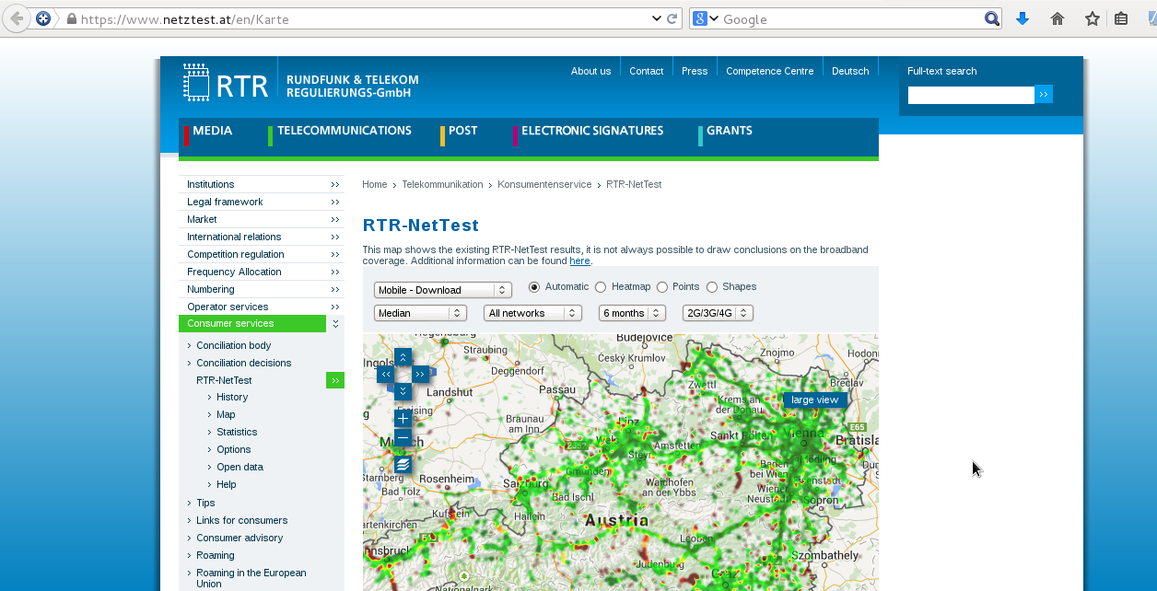
Austria - https://www.netztest.at/en/Karte

Slide 26
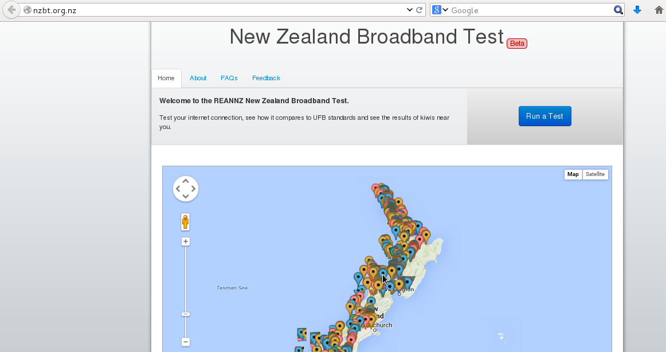
New Zealand - http://nzbt.org.nz/

Slide 27
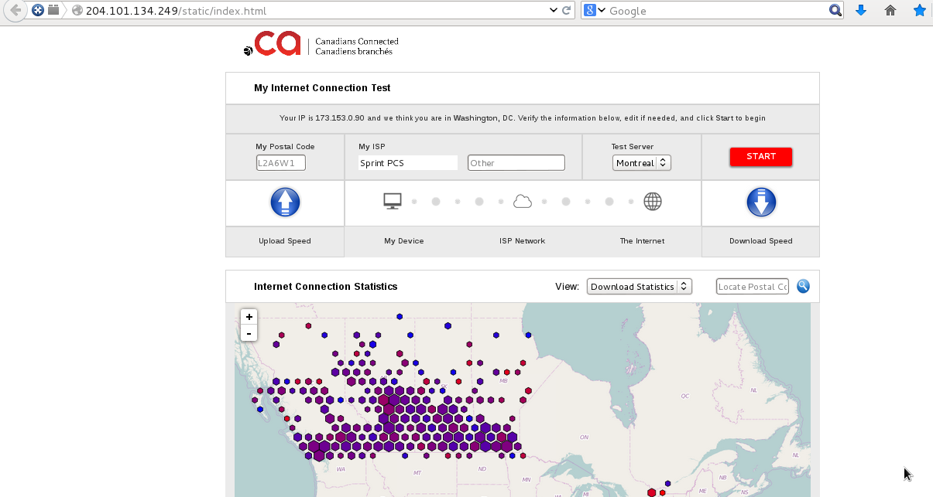
Canada - http://204.101.134.249/static/index.html

Slide 28
M-Lab Tools in Development Enabling Easier Reports, Visualizations, APIs, Automation

Slide 29
In Development: M-Lab Integration Toolkit
Prototyping easy to integrate solutions for Regulators:
Sample US Map: http://files.opentechinstitute.org/~kinkade/leaflet/mlab.html
Sample Thailand Map: http://files.opentechinstitute.org/~critzo/mlab/collab/nbtc/mlab.html
NDT test: http://files.opentechinstitute.org/~kinkade/ndt_js/
M-Lab Observatory – a strong visualization of M-Lab data http://measurementlab.net/observatory
Additional software tools to support easier data access (M-Lab Telescope, C/C++ Libraries, WebSockets support)

Slide 30
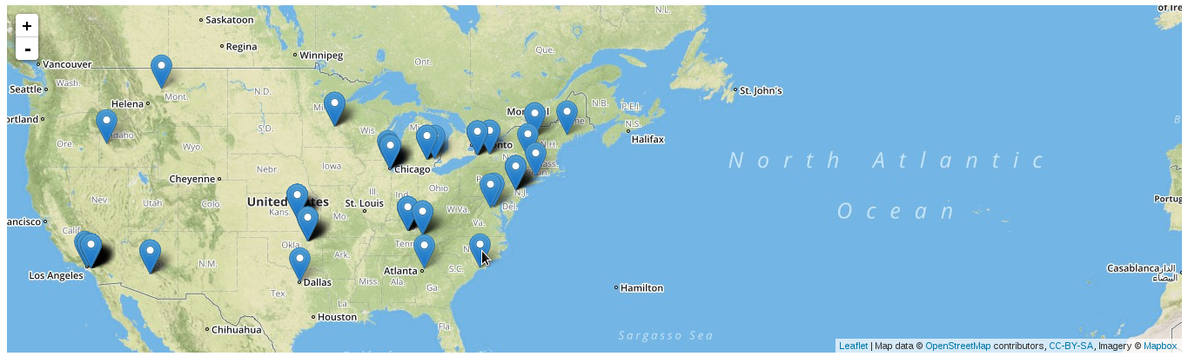
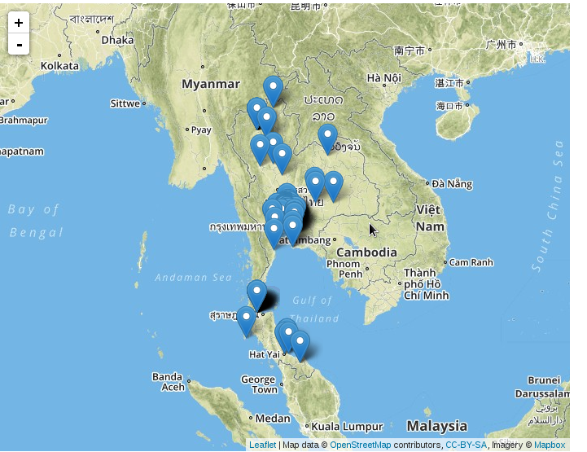
Sample Embeddable Map, United States
Sample Embeddable Map, Thailand
NOTE: Many regions may not yet have sufficient test volume to be able to produce authoritative maps

Slide 31

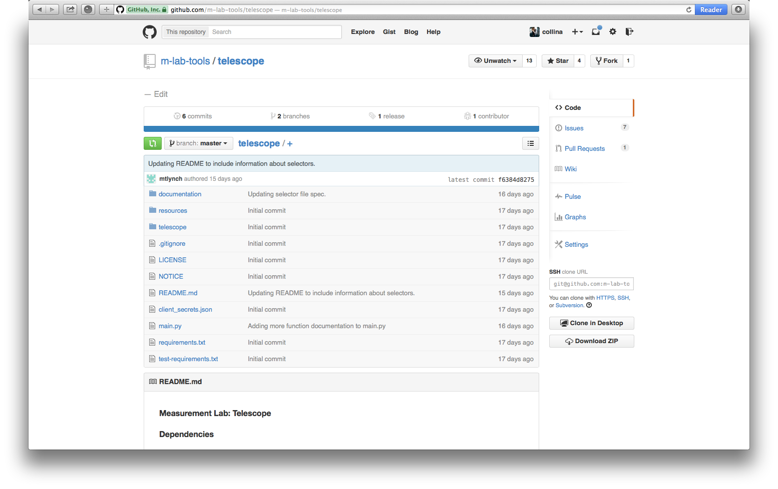
Measurement Lab Telescope
Python to extract M-Lab data

Slide 32
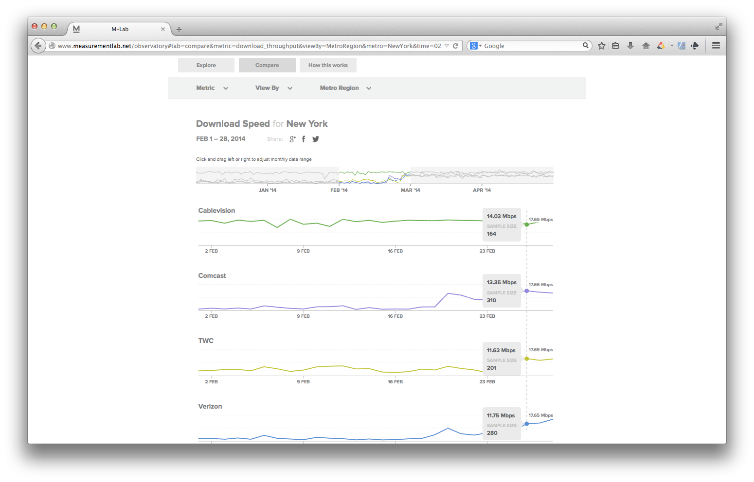
Measurement Lab Observatory
Currently US Only

Slide 33
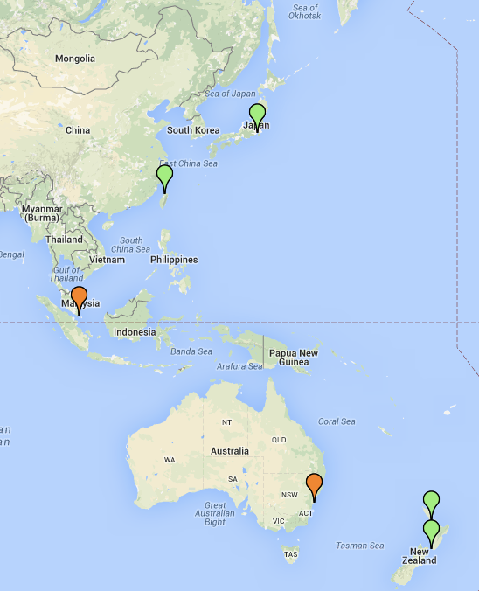
Growing the Network
Infrastructure Update: Expansion of Server Coverage in Asia, North America and Africa.
Deployment of M-Lab sites to locations in:
Canada (Calgary, Montreal, Toronto)
Africa (Tunisia)
Asia (Singapore, Thailand)
Deployment to Transit ISPs:
Cogent
Level 3
NTT

Slide 34
There is still much more in Measurement Lab’s dataset. Please explore.
measurementlab.net

Slide 35
Open Questions?
Additional Resources:
M-Lab Discuss Mailing List:
http://goo.gl/Z31o6d
M-Lab Operations Mailing List:
http://goo.gl/4bZBwJ
Upcoming Conference Events:
https://2015.apricot.net/
measurementlab.net

